Slide 1

Constructive Cost Model:
By Sadik Ittesaf Abir
Jannatul Ferdous Sristy
Sumit Saha
Fahim

Slide 2
Project Type : Organic
Coefficient: 2.4
SLOC=15000
Effort = PM = Coefficient of Effort Factor * (SLOC/1000) ^ P
PM (person Months) = (2.4x (1500/1000) ^1.05) = 42 Months
DM = 2.5(constant)*(PM^T)
Dev. Time, DM = (2.50 x 42^0.38) = 11 Months = 2220 Working Hours
Required people, ST = PM/DM =42/11= 4 people

Slide 3
Budgeting:
Developer Salary in 11 Months:
Per Developer Salary Per Working Hour = 500 taka
Total Developer Salary = 500 *2220 = 11,10,000 Taka
Requirement Analysis:
Time Needed: 1 month (20 Working Days = 200 Working hours)
Req Analysis Person's Hourly Wage = 400 taka
Total Req Analysis Expense = 400 x 200 = 80,000 taka
Transportation Cost Estimation: 20.000 taka
Training & Hardware Expenses estimation: 200,000 aka

Slide 4
Rent Expenses:
Room Per Month- 15.000 taka
Total in 11 Months 15,000 x11 = 1,65,000 taka
Total Utilities in 11 Months= 3000 x11 = 33,000 taka
Maintenance (Till. 6 Months after Delivery):
Expense Per Hour= 1000 taka
Total Estimated Time Needed for Maintenance = 50 Hours
Total Estimated Maintenance expense = 50 x1000 = 50,000 taka
Total estimated expense: 11,10,000 + 80,000 + 20,000 + 200,000 + 1,65,000 + 33,000 + 50,000 = 16,58,000
Profit:
25% of Total Estimated Expense 16,58,000*25% = 4,14,500 Taka
Project Budget: 16,58,000 + 4,14,500 = 20,72,500 Taka

Slide 5
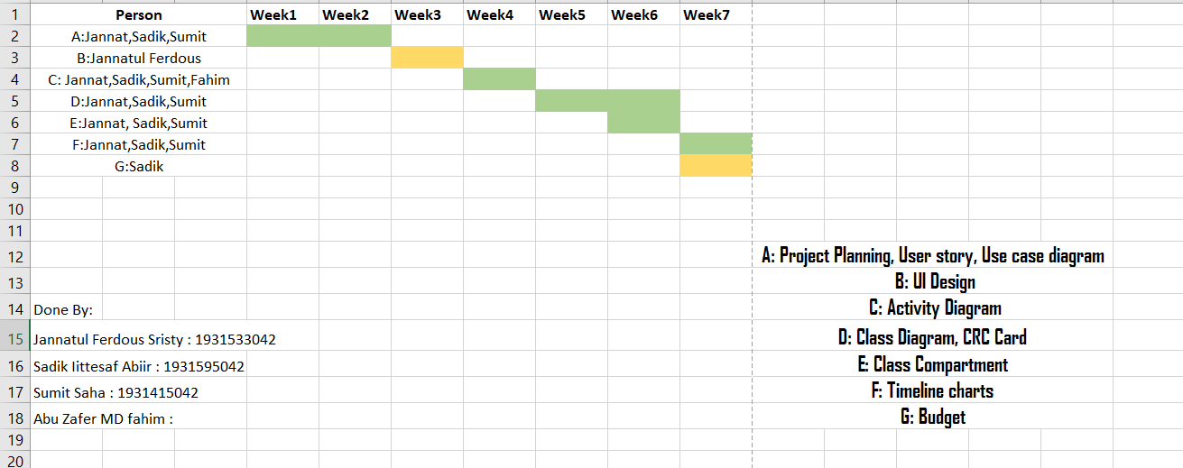
Gantt Chart:

Slide 6
